Slide 1
AUTOMATIC PHISHING URL DETECTOR USING C
PRESENTED BY:
Riki karn THA081BCT030
Ronit Shrestha THA081BCT031
Samrat Tamang THA081BCT033
Sri Krishna Lamichhane THA081BCT041
Department of electronics and computer
Thapathali Campus
12th March 2024

Slide 2

INTRODUCTION
WHAT IS PHISING?
Phishing is a method to steal information.
Attackers disguise as trusted websites or
services.
Phishing emails often contain malicious
website links.
Victims unknowingly enter sensitive data
on fake sites.

Slide 3
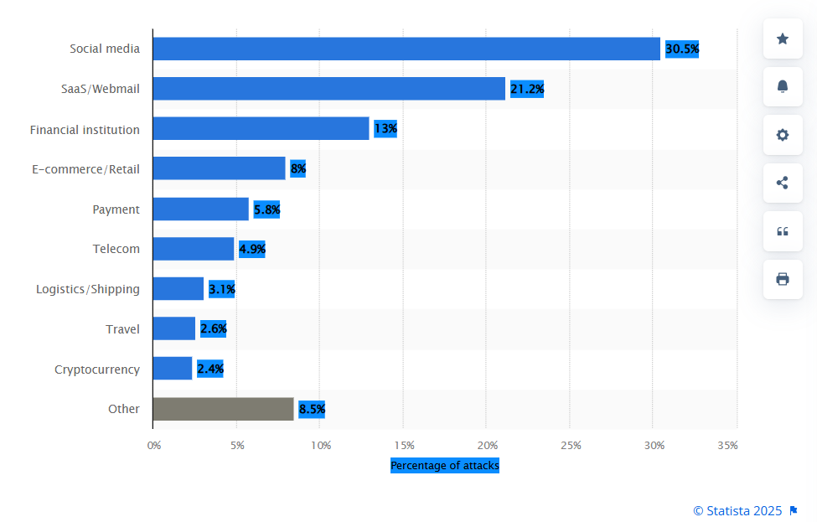
Online industries worldwide most targeted by phishing attacks as of 3rd quarter 2024 according to statistica

Slide 4
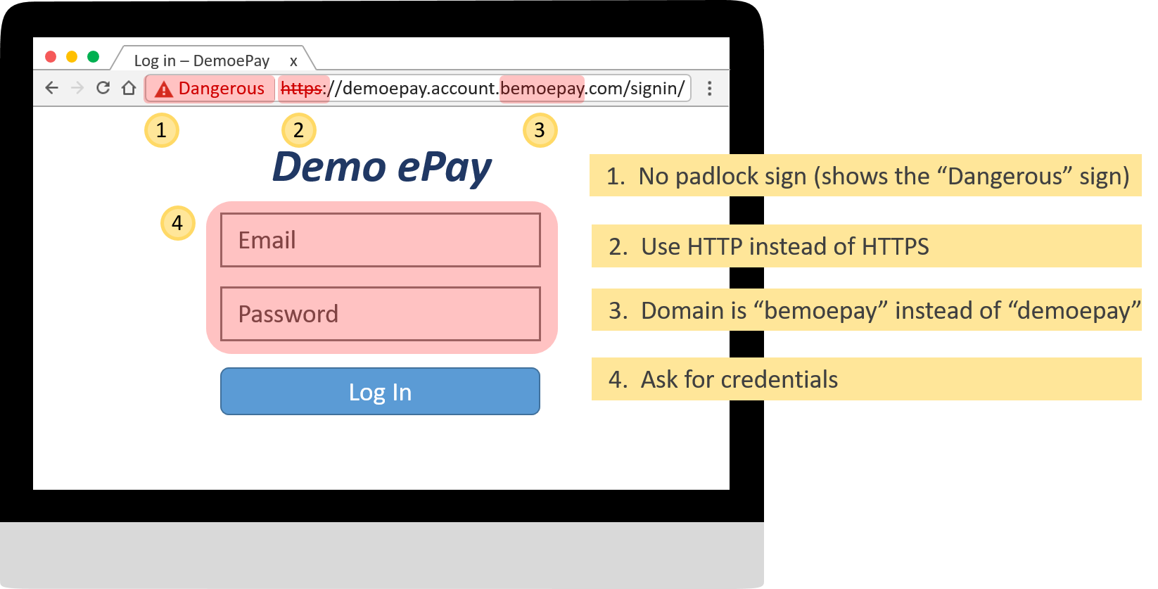

Slide 5
PROBLEM STATEMENT
Traditional detection methods are either slow
or inaccurate.
Depends upon AI and machine learning
require large datasheet, continuous training, significant resources
Our goal is to develop an efficient system that assigns a security percentage score to URLs, helping users assess risk.

Slide 6
PROPOSED SOLUTION
Develop a system in C programming language that:
Uses Levenshtein Distance for URL similarity checking.
Checks for blacklisted urls
Utilizes File Handling to manage a database of trusted and phishing URLs.
Use keyword filtering
Checks special character
Checks Url length
The system outputs a security percentage score based on multiple detection methods.

Slide 7
SYSTEM ARCHITECTURE
s
Phishing Detection
Start
URL Input
URL Processing
Stop
Classification of suspeciousness
Suspecious scrore
Display result

Slide 8
TECHNICAL DETAILS
1. URL Processing
Extracts key parts like domain, path, and query.
Identifies suspicious patterns or characters.
Checks URL length, structure, and redirections.
Separates domain extensions (.com, .net, etc.).
Filters out unusual port numbers or encodings.

Slide 9
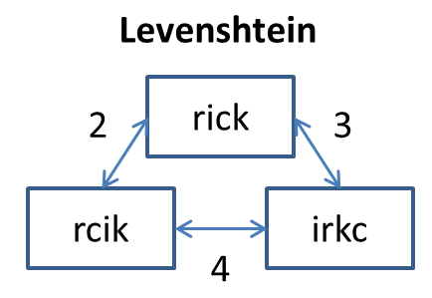
2. Levenshtein Distance
Measures text similarity using character changes.
Counts insertions, deletions, and replacements.
Efficient for detecting typo-squatting attacks.
Helps identify lookalike domains easily.
3. Blacklist Checking
Compares URLs with a stored phishing list.
Uses file handling to read known URLs.
Flags exact or closely matching domains.
Efficient for known phishing site detection.

Slide 10
4. Keyword Filtering
Scans URLs for suspicious terms like “login”, “verify”.
Identifies common phishing-related keywords.
Filters unsafe links before further checks.
Enhances detection accuracy with word patterns.
5. Special Symbol Checking
Detects unusual symbols like @, %, and //.
Identifies URL obfuscation tactics by attackers.
Flags URLs with encoded or hidden data.
Focuses on tricky phishing URL patterns.
Ensures clean and standard URL structure.

Slide 11
6. API Embedding
Uses web APIs for real-time URL checks.
Retrieves threat intelligence for detection.
Enhances detection by checking live data.
Reduces manual URL list updating needs.
Improves accuracy with dynamic data.
7. Percentage Calculation
Combines all detection method results.
Assigns weights to each method’s score.
Calculates a final security percentage.
Displays “Secure”, “Suspicious”, or “Unsafe”.
Provides clear insight for user safety.

Slide 12
C-COMPONENT IMPLEMENTED
Function
String handling
File handling
Pointer
Structure
Array
Conrtol structure
Algorithms like binary sorting

Slide 13

CHALLENGE FACED
Merging Different Functions
Large Program Management
Understanding Algorithms
File Handling Issues
Ensuring Accuracy and Efficiency
Team Collaboration and Version Control

Slide 14
FUTURE IMPROVEMENT
Adding domain age checks to detect newly registered phishing domains.
Implementing IP-based detection for enhanced accuracy.
Enhancing the algorithm with machine learning for smarter detection.
Enhancing dataset with real-time data feeds.
Developing a browser extension for user-friendly alerts

Slide 15

CONCLUSION
Our system effectively detects potential phishing sites.
It assigns a security percentage score for awareness.
"Your security starts with awareness. Stay alert, stay safe!"

Slide 16


